Slide 1
Data Visualization
Notes:
Go through the absolute basics just to get started.
There is so much more to explore… definitely learn from your mentors about data visualization!

Slide 2
What is data visualization?
Present data in a graphical manner
Conveys information about the data (hopefully in a way that is easy to understand!)

Slide 3
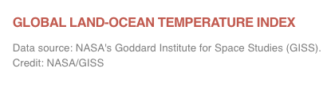
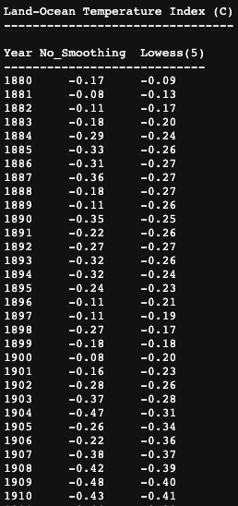
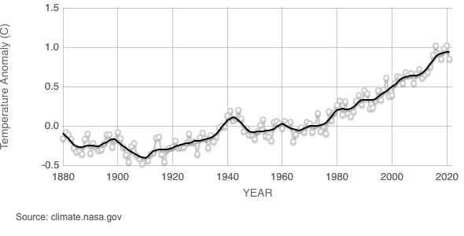
What is data visualization?
Present data in a graphical manner
Conveys information about the data (hopefully in a way that is easy to understand!)
Notes:
https://climate.nasa.gov/vital-signs/global-temperature/
This graph illustrates the change in global surface temperature relative to 1951-1980 average temperatures.
Big idea we can get from graph: Earth’s surface continues to significantly warm, with recent global temperatures being the hottest in the past 2,000-plus years.
LOWESS (Locally Weighted Scatterplot Smoothing) is a tool that creates a smooth line through a scatter plot to help you to see relationship between variables and foresee trends (useful especially when data is noisy)

Slide 4

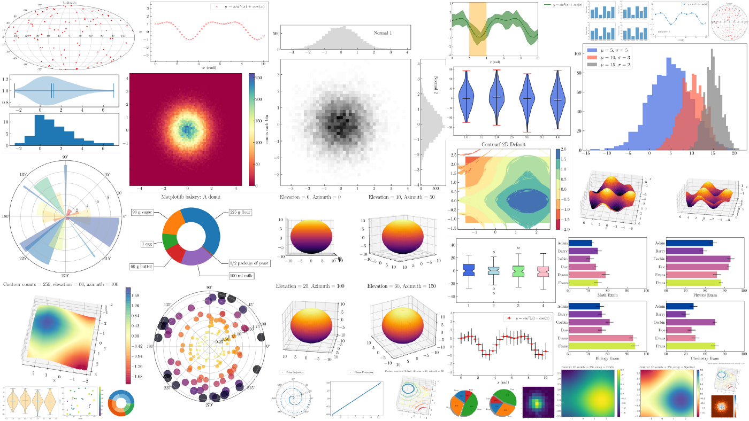
Matplotlib
We will be using the library matplotlib today to create various plots
We will specifically use the pyplot module
import matplotlib.pyplot as plt
towardsdatascience.com

Slide 5
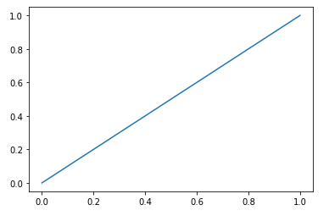
Basic Plotting
plt.plot(xpoints, ypoints)
Example:
xpoints = [0, 1]
ypoints = [0, 1]
plt.plot(xpoints, ypoints)
What kind of plot is this?
What is missing from this plot?

Slide 6
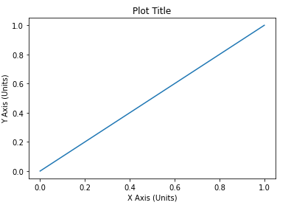
Basic Plotting - Line Plots
Example:
xpoints = [0, 1]
ypoints = [0, 1]
plt.title(“Plot Title”)
plt.xlabel(“X Axis (Units)”)
plt.ylabel(“Y Axis (Units)”)
plt.plot(xpoints, ypoints)
Notes:
More customization practice in Jupyter notebooks

Slide 7
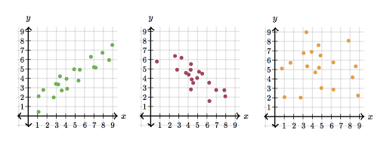
Scatter Plots
Useful when you are looking for relationships between two variables.
plt.scatter(xpoints, ypoints)
What relationships between x and y do we see in the above scatter plots?
Notes:
Positive correlation: as one variable increases, so does the other
Negative correlation: as one variable increases, the other decreases
No correlation: no clear relationship between two variables

Slide 8
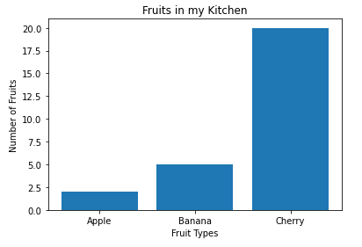
Bar Plots
Useful when comparing different categories of data.
Example:
fruits = [‘Apple’, ‘Banana’, ‘Cherry’]
numberFruits = [2, 5, 20]
plt.title(‘Fruits in my Kitchen’)
plt.xlabel(‘Fruit Types’)
plt.ylabel(‘Number of Fruits’)
plt.bar(fruits, numberFruits)

Slide 9
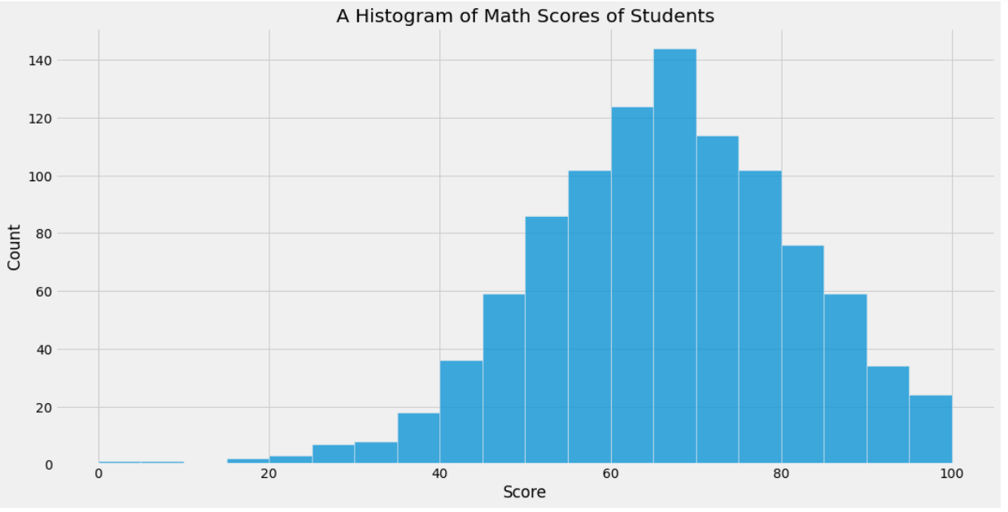
Histograms
Used to show the frequency with which specific values, or values within ranges, occur in a set of data.
plt.hist(data)
Review: What is the command to do this using the pandas library?
data.hist()
Notes:
Data is sequence of data - list, array
The horizontal axis of a histogram displays the number range and the vertical axis represents the amount of data (frequency) that is present in each range.

Slide 10
Bar Plot vs. Histogram
Bar graph compares categorical variables (like categories of fruits)
Whereas histograms depict the frequency of the values in each bin

Slide 11

In notebook 08_data-visualization, complete the following section:
1 - Matplotlib (includes subsections 1.1, 1.2, 1.3, 1.4)
Notes:
Stop/Start Here

Slide 12
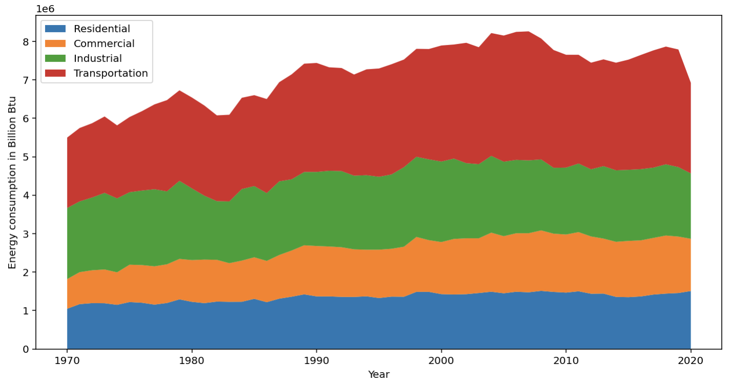
Challenge - Working with Energy Data
You’ll get to work with real data from US Energy Information Administration (EIA). You’ll get to create some neat graphs like stacked bar charts and stacked area charts!

Slide 13
In notebook 08_data-visualization, complete the following section:
2 - Working with Data: Energy

Slide 14



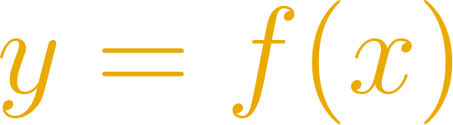
What is a mathematical function?
a sort of machine!
🚨
📣
🔘
OUTPUT
INPUT
🔩
💡 💡 💡
🔩
independent variable
dependent variable

Slide 15
What is a 1D mathematical function?
relationship between 1 input, say x, and 1 output, say y
x
y
f
f provides a rule to obtain y from x

Slide 16
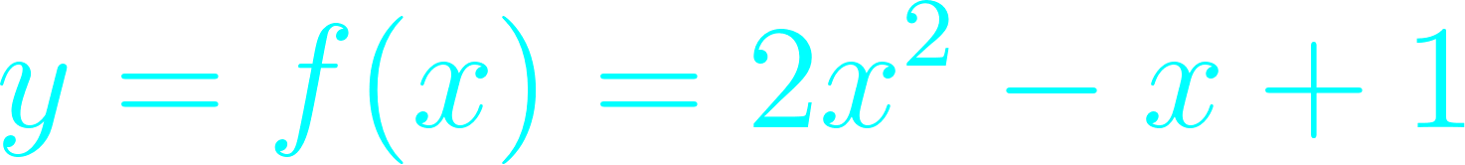
What is a the graph of a 1D mathematical function?
y
a curve that marks the path of f
example:
x | y
-2 | 11
-1 | 4
0 | 1
1 | 2
2 | 7
x

Slide 17
What is a the graph of a 1D mathematical function?
y
a curve that marks the path of f
example:
it’s a parabola!
x

Slide 18
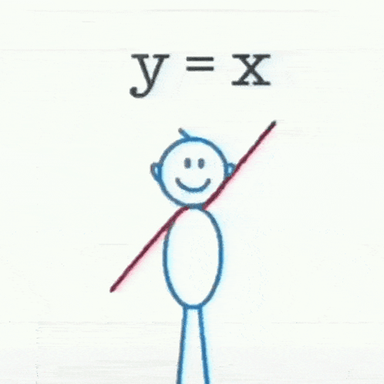
Examples of functions and their graphs/plots
y
bell
line
Gaussian
linear
x
wave
sinusoidal

Slide 19
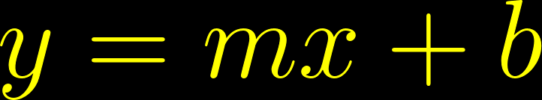


Linear functions
y
line
x

Slide 20
Linear functions
m
b
y
y
positive and large
positive
negative
positive and small
zero
negative
x
x
zero

Slide 21
Simple models with linear functions
how much money will you have saved by the end of BLDAP?
how fast is your commute?
regression line
= line that best approximates our data
home-lab distance
savings
commute time
BLDAP weeks

Slide 22
In notebook 08_data-visualization, complete the following sections:
3 - What is a mathematical function?
4 - Linear functions and simple models
When you are done, complete the Exit Ticket!
There is also a bonus section (Gaussian functions and probability distributions)

